Slide 1


Frontline Absence Management Training

Slide 2
What You Will Learn…
Logging In
Creating an Absence
Assigning a Substitute to a Prearranged Absence
Cancel an Absence
Preferred Substitute
Contact Teachers On Call

Slide 3
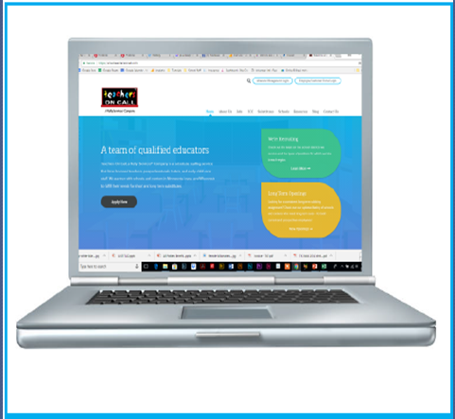

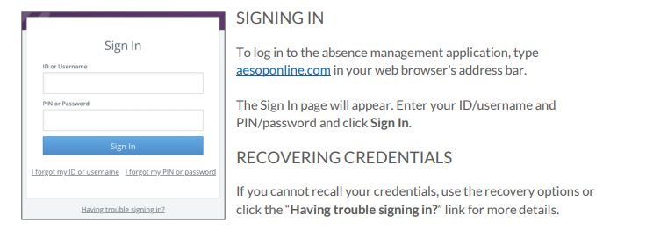
Logging in to Absence Management
Go to www.teachersoncall.com
Click on the Absence Management Log in.

Slide 4
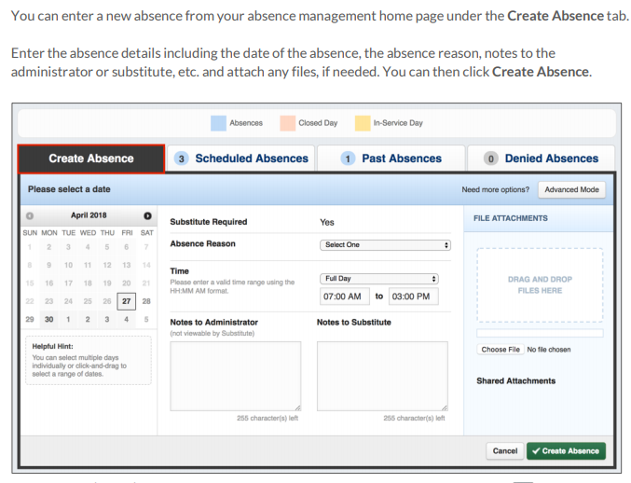
Creating an Absence

Slide 5

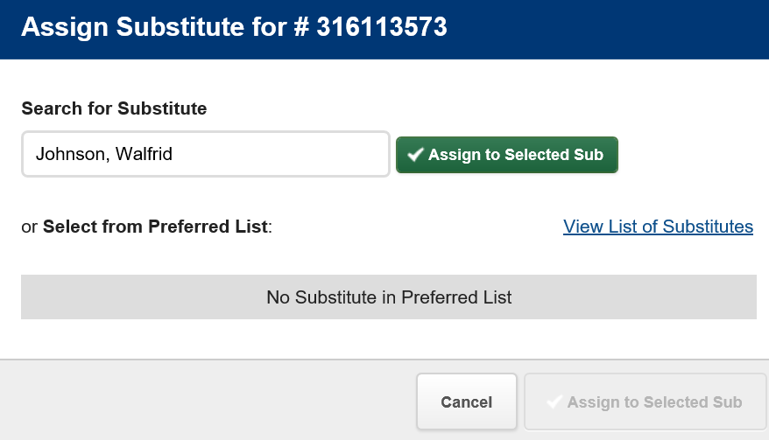
Assigning a Prearranged Substitute

Slide 6
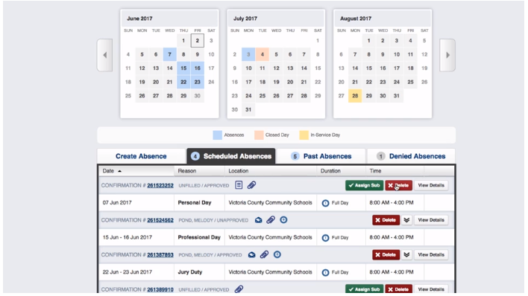
Cancel an Absence

Slide 7
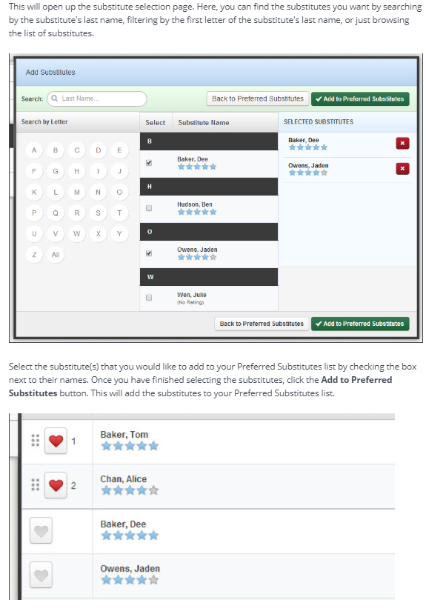
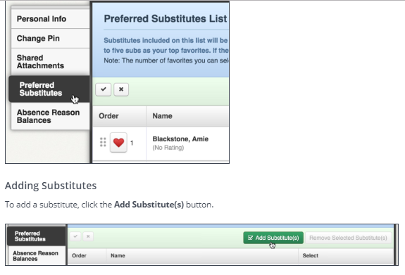
Preferred Substitutes
Go to Settings on your home page

Slide 8
Contact Teachers On Call
Substitute Services Team – 1-800-713-4439
substituteservices@teachersoncall.com
Contact us for assistance regarding the following:
Help with creating or cancelling an absence
Mid-day, last minute absences and past absences
Assistance with Frontline Absence Management

